Slide 1

Introduction to Data Structures
Lecture 1
Created By: Neeraj Khanna
‹#›

Slide 2
Agenda
What is Data Structure.
Data Structures Classification
Operations on Data Structure
Quiz
‹#›

Slide 3
Data Structure
Data Structure is all about how you can organize/structure your data so that you can store it and use it efficiently.
‹#›

Slide 4
Why Data Structure
Human requirements with computers are going to complex day by day. To solve the complex requirements in efficient way we need this study.
Provide fastest solution of human requirements.
Provide efficient solution of complex problem.
Space
Time
‹#›

Slide 5
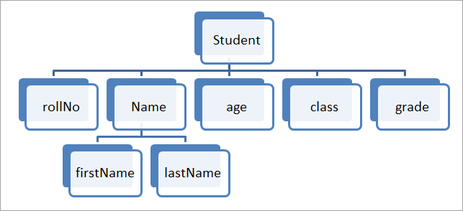
Basic Terminology
Data: Data are values or set of values. In the figure, student Roll No. can be data.
Group item: This is the data item that has more than one sub-items. In the figure, Student_name has First Name and Last Name.
Record: It is a collection of data items. In the figure, data items like student Roll No., Name, Class, Age, Grade, etc. form a record together.
Entity: It is a class of records. In the figure, the student is an entity.
Attribute or field: Properties of an entity are called attributes and each field represents an attribute.
File: A file is a collection of records. In the above example, a student entity can have thousands of records. Thus a file will contain all these records.
‹#›

Slide 6
Classification of Data Structure
Simple Data Structure: It can be constructed with the help of primitive data structure. A primitive data structure used to represent the standard data types of any one of the computer languages.
Compound Data Structure: It can be constructed with the help of any one of the primitive data structure and it is having a specific functionality.It can be designed by user. It can be classified as Linear and Non-Linear Data Structure.
‹#›

Slide 7
Classification of Data Structure
Linear Data Structures: Linear data structures have all their elements arranged in a linear or sequential fashion. Each element in a linear data structure has a predecessor (previous element) and a successor (next element)
Linear data structures are further divided into static and dynamic data structures. Static data structures usually have a fixed size and once their size is declared at compile time it cannot be changed. Dynamic data structures can change their size dynamically and accommodate themselves.
The most popular example of linear static data structure is an array.
Non-Linear Data Structures: In this data is not arranged sequentially, instead, it is arranged in a non-linear fashion. Elements are connected to each other in a non-linear arrangement.
Non-linear data structures are Trees and Graphs.
‹#›

Slide 8
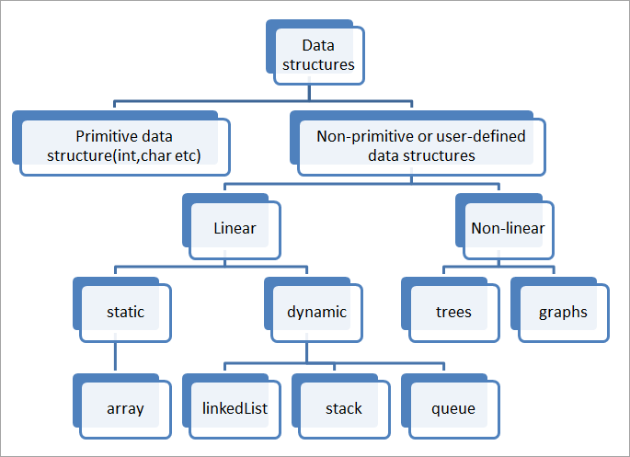
‹#›

Slide 9
Operation on Linear/Non-Linear Data Structure
Insertion: Insertion operation deals with adding an element to the data structure.
Deletion: Deletion operation removes an element from the data structure.
Traversing: We traverse a data structure when we visit each and every element in the structure. Traversing is required to carry out certain specific operations on the data structure.
Searching: This operation is performed to search for a particular element or a key.
Sorting: Sorting operation involves arranging the elements in a data structure in a particular order either ascending or descending.
‹#›

Slide 10
Data Structures
Following are the different types of Data Structures
Array
Linked List
Stack
Queue
Trees
Graph
‹#›

Slide 11
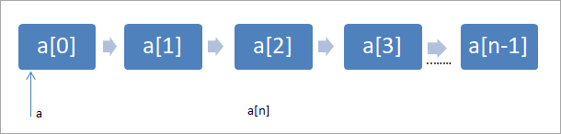
Array
An array is a sequential collection of elements of the same type. Each element of the array can be accessed using its position in the array called an index or subscript of the array.
The array is the simplest data structure and is efficient as elements can be accessed using subscripts directly. But adding or deleting the array elements is difficult. Hence we use arrays only in simple applications or in applications where addition/deletion of elements is not required.
‹#›

Slide 12
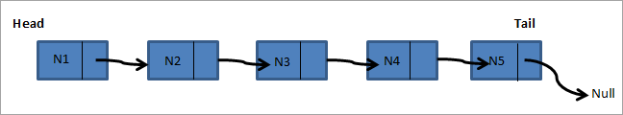
Linked List
A linked list is a collection of nodes. Each node contains the data element and a reference/link to the next node. Nodes can be added and deleted dynamically. A linked list can be a singly linked list in which each node has a reference/link to the next element only. For the last element, the next reference/link is set to null.
In the doubly linked list, each node has two references one to the previous node and the second one to the next node. For the first node, the previous reference is null and for the last node, the next reference is null.
As shown in the figure above, the beginning of the list is called the head while the end of the linked list is called the tail. As shown above, each node has a reference to the next element. We can easily add or delete elements by changing the reference/link to the next node.
‹#›

Slide 13
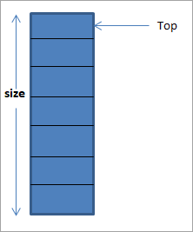
Stack
Stack is a linear data structure in which the elements can be added or removed only from one end known as “Top” of the stack. In this way, stack exhibits LIFO (Last In, First Out) type of memory access.
As shown in figure , elements in the stack are always added at one end and also removed from the same end. This is called the “Top” of the stack. When an element is added, it is pushed down the stack and top of the stack is incremented by one position.
Similarly, when an element is removed, the top of the stack is decremented. When a stack is empty, the top of the stack is set to -1. There are two main operations “Push” and “Pop” that are performed on the stack.
‹#›

Slide 14
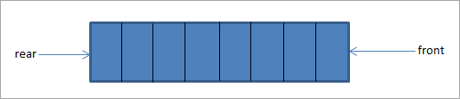
Queue
The queue is yet another linear data structure in which the elements are added at one end called “rear” and deleted from another end called “front”. Queue demonstrates FIFO (First In, First Out) the type of memory access methodology.
The above diagram shows a queue with rear and front ends. When the queue is empty, the rear and front pointers coincide with each other.
‹#›

Slide 15
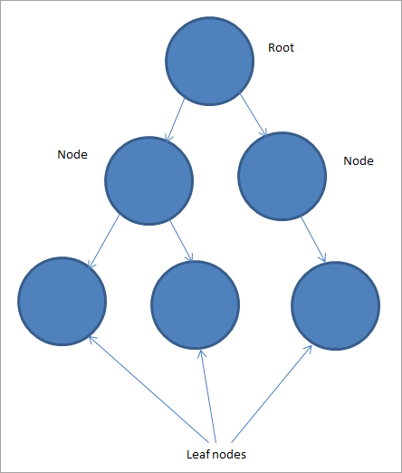
Trees
Trees are non-linear multilevel data structures having a hierarchical relationship between the elements. Elements of the tree are called Nodes.
The node at the top is called the root of the tree. The root can have one or more child nodes. The subsequent nodes can also have one or more child nodes. The nodes that do not have child nodes are called leaf nodes.
Depending on the number of nodes, child nodes, etc. or the relationship between the nodes, we have different types of trees.
‹#›

Slide 16
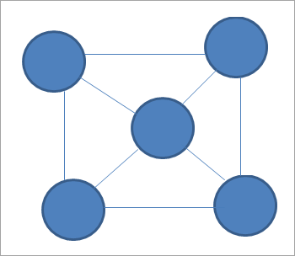
Graph
The graph is a set of nodes called vertices connected to each other by means of the links called Edges. Graphs can have a cycle inside it i.e. the same vertex can be a starting point as well as the end point of a particular path. Trees can never have a cycle.
This diagram is an undirected graph. We can also have directed graphs where we represent the edges using directed arrows.
‹#›

Slide 17
Quiz
‹#›

Slide 18
Which of these best describes an array?
a) A data structure that shows a hierarchical behaviour
b) Container of objects of similar types
c) Arrays are immutable once initialised
d) Array is not a data structure
‹#›

Slide 19
A Queue follows
a) FIFO (First In First Out) principle
b) LIFO (Last In First Out) principle
c) Ordered array
d) Linear tree
‹#›

Slide 20
Which of the following points is/are true about Linked List data structure when it is compared with array
a) Arrays have better cache locality that can make them better in terms of performance.
b) It is easy to insert and delete elements in Linked List
c) Random access is not allowed in a typical implementation of Linked Lists
d) The size of array has to be pre-decided, linked lists can change their size any time.
e) All of the above
‹#›

Slide 21
The minimum number of fields with each node of doubly linked list is
a) 1
b) 2
c) 3
d) 4
‹#›

Slide 22
A stack follows
a) FIFO (First In First Out) principle
b) LIFO (Last In First Out) principle
c) Ordered array
d) Linear tree
‹#›

Slide 23
References
Kindly add book and Internet resource links
‹#›

